Slide 1
Mathematics of Intelligent Systems
Mis
Batch A _ Group 12

Slide 2
Team members
J Ajay surya
Mohitha
CB.EN.U4AIE21018
01
02
CB.EN.U4AIE21032
Prasanna Teja
Sai Ravula
CB.EN.U4AIE21035
04
03
CB.EN.U4AIE21041

Slide 3
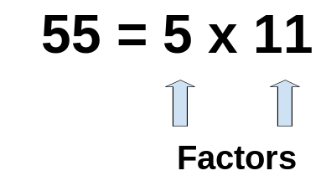
What is Matrix factorization?
Factorization is the method of expressing something big as a product of smaller factors.
Matrix factorization is a technique used to decompose a matrix into two or more low rank matrices, enabling the representation of original matrix in a more compact form

Slide 4
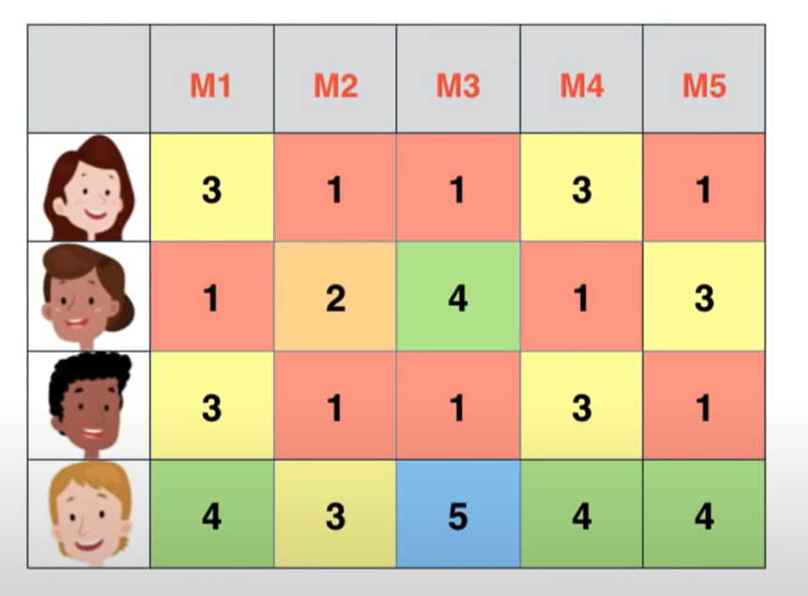
Dependent rows & columns
There are 4 users and 5 movies and this
matrix is called ratings matrix where the
element y[i,j] represents the rating
given to movie i by user j
Take a minute & try to find all the
possible dependencies from the matrix!

Slide 5
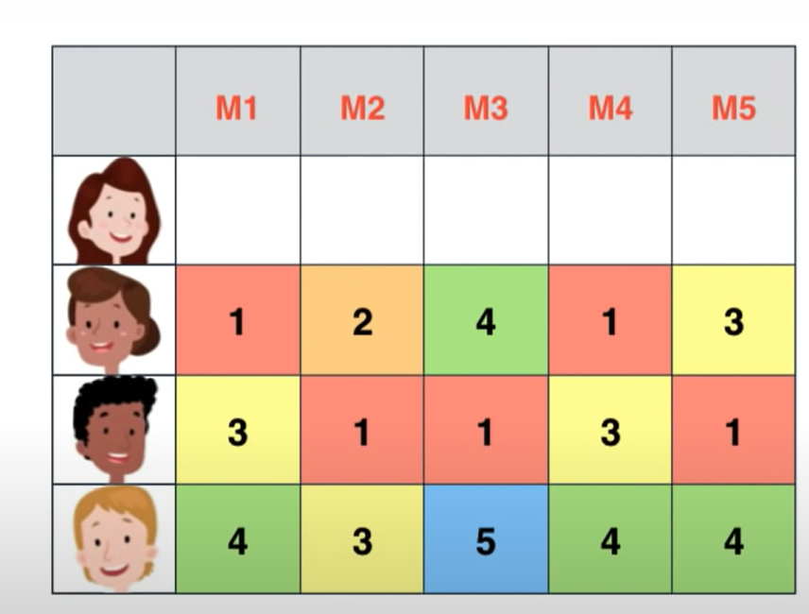
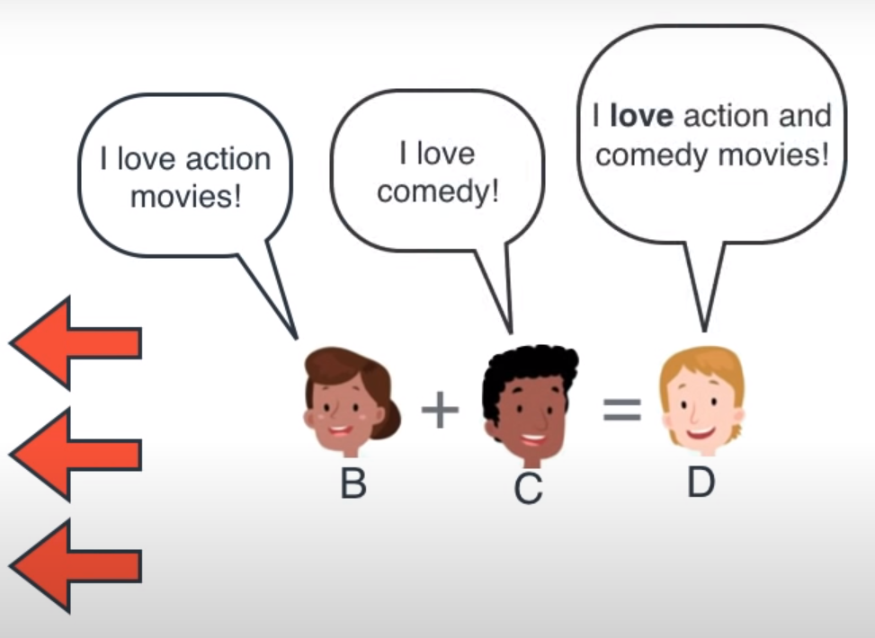
Dependent rows & columns

Slide 6
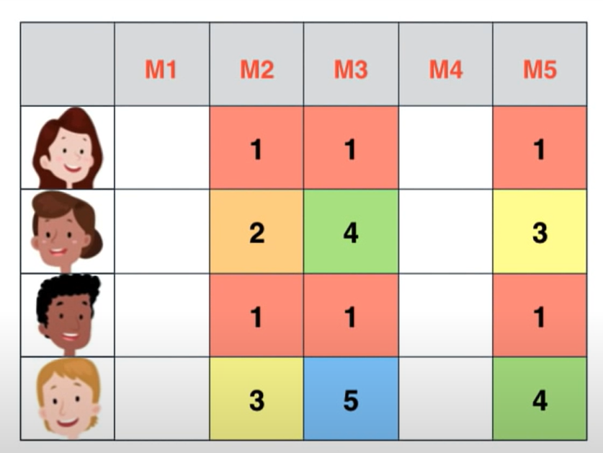
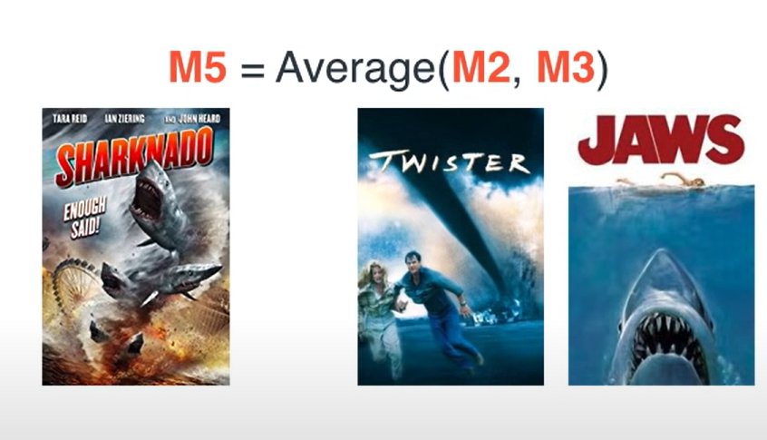
Dependent rows & columns
Movie 2 is twister so its about a tornado and movie 3 is Jaws which is about sharks and movie 5 is Sharknado which is basically about both Tornados and sharks

Slide 7
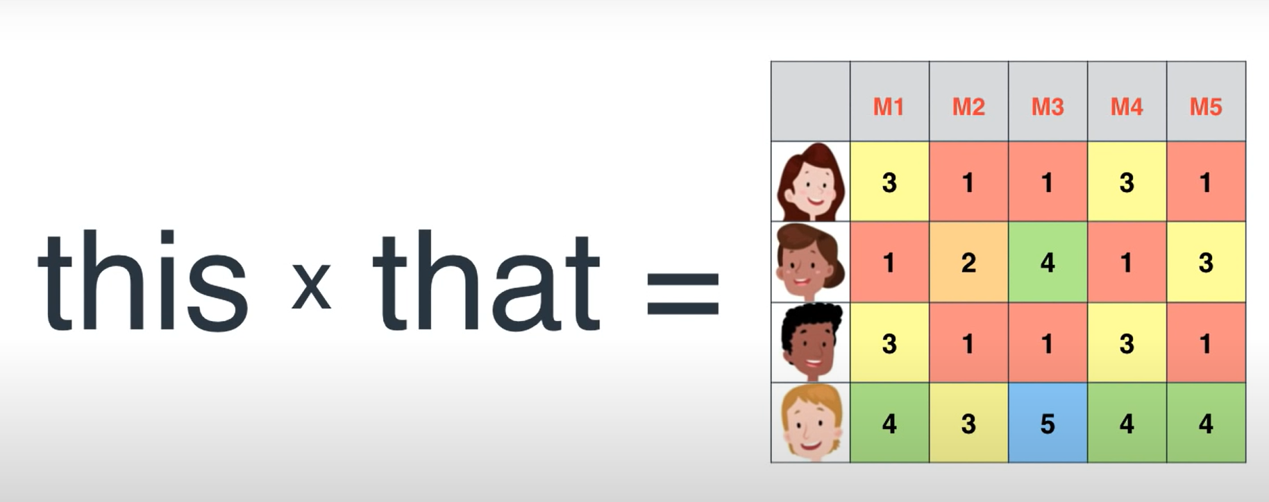
Now how to find the smaller matrices whose product is a big one?

Slide 8

Features
Our features can be anything like comedy,action,drama,does it have a sad dog, or is the actor Ryan etc..
Features are characteristics of an item. In our case, features of the movies can be its genre, actors, plot, etc.

Slide 9
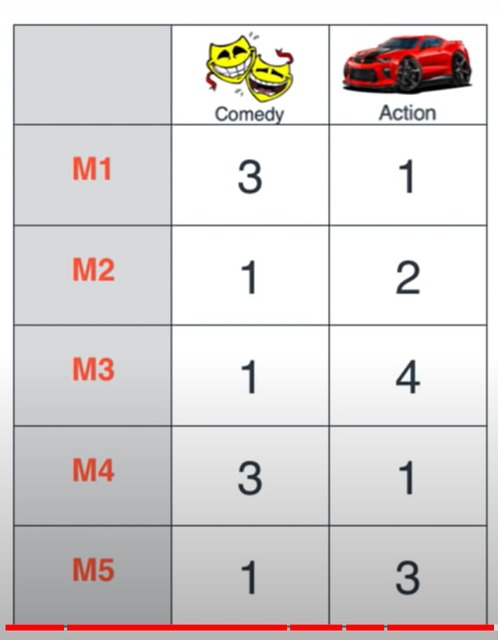
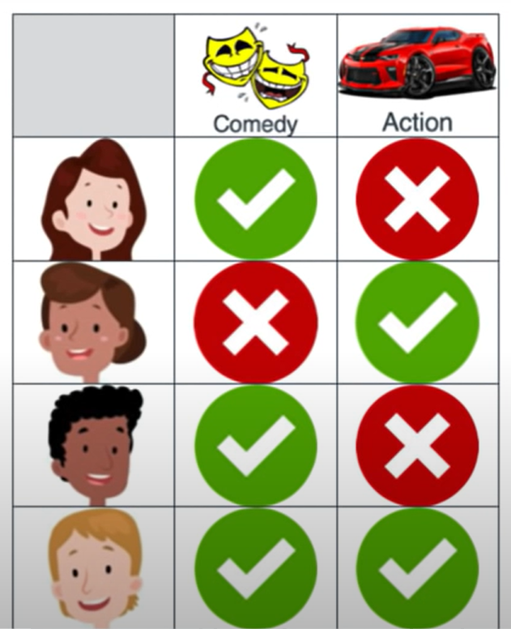
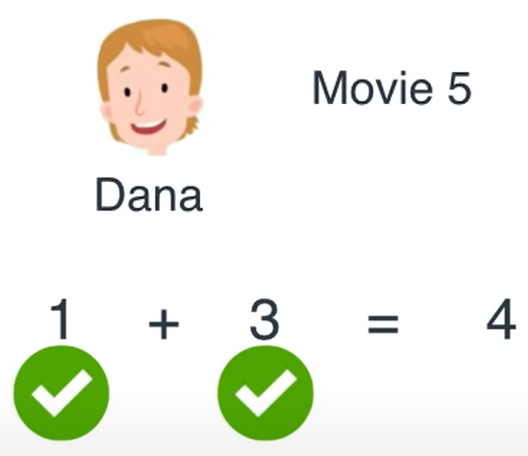

Dot product
Lets take 2 features comedy & action
Dot product is a way to guess the rating based on how much a user likes comedy and action and how much a movie contains comedy & action

Slide 10
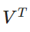
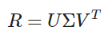
Matrix Factorization via Singular Value Decomposition
There are many different ways to factor matrices, but singular value decomposition is particularly useful for making recommendations.
R is users's ratings matrix, U is the user "features" matrix, Σ is the diagonal matrix of singular values (essentially weights), and VTis the movie "features" matrix. U and VT are orthogonal, and represent different things. U represents how much users "like" each feature and represents how relevant each feature is to each movie.
To get the lower rank approximation, we take these matrices and keep only the top k features, which we think of as the underlying tastes and preferences vectors.

Slide 11
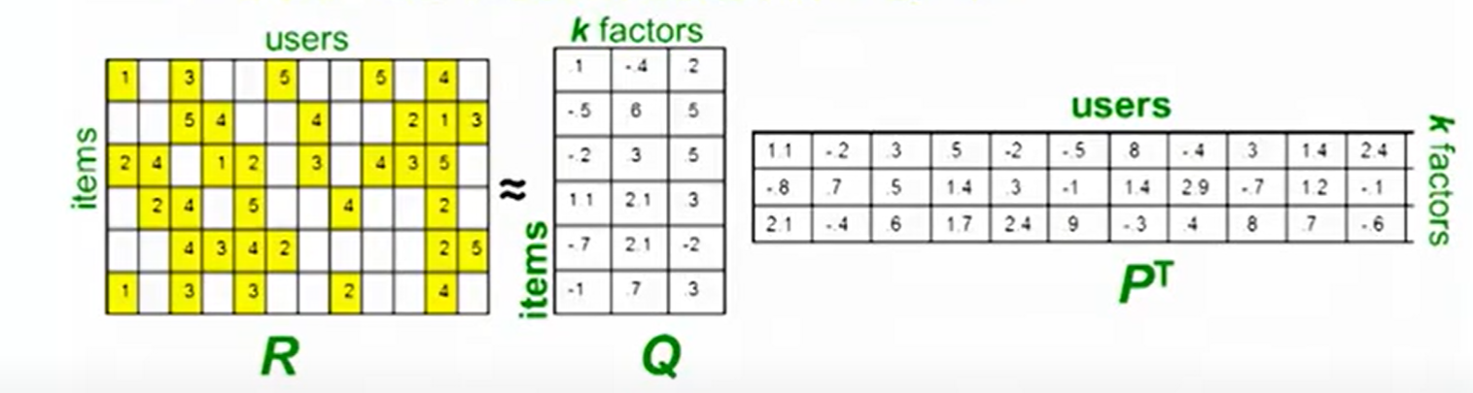
Recommendations via optimization
Quantify goodness using RMSE(Root mean squared error)
Lower RMSE => better recommendations
SVD on Netflix data :

Slide 12
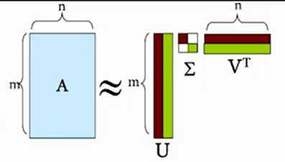
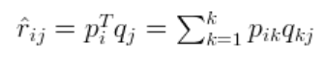
Singular value decomposition(SVD)
Each row of P would represent the strength of the associations between a user and the features. Similarly, each row of Q would represent the strength of the associations between an item and the features
We can get the prediction of a rating of an item by the calculation of the dot product of the two vectors
So in our case A=R,Q=U,PT=Σ VT
A : Input data matrix
U: Left singular vectors
Σ : Singular values
V : Right singular values

Slide 13
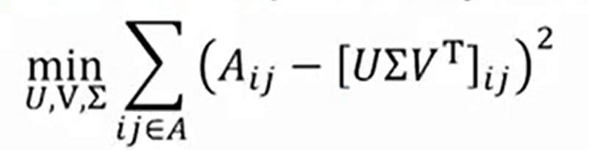
HOW DO WE FIND THE RIGHT FACTORIZATION FOR A MATRIX?
Machine Learning is the solution. The model learns to find latent factors to factorize the rating matrix.
To arrive at the best approximation of the factors, RMSE(root mean squared error) is the cost function to be minimized. After Matrix factorization is done, squared error is calculated for every movie rating in the rating matrix and the root value of the mean of squared error values are minimized.
In order to minimize RMSE to learn the factors, Gradient Descent and Alternating Least Squares are the two most used techniques

Slide 14
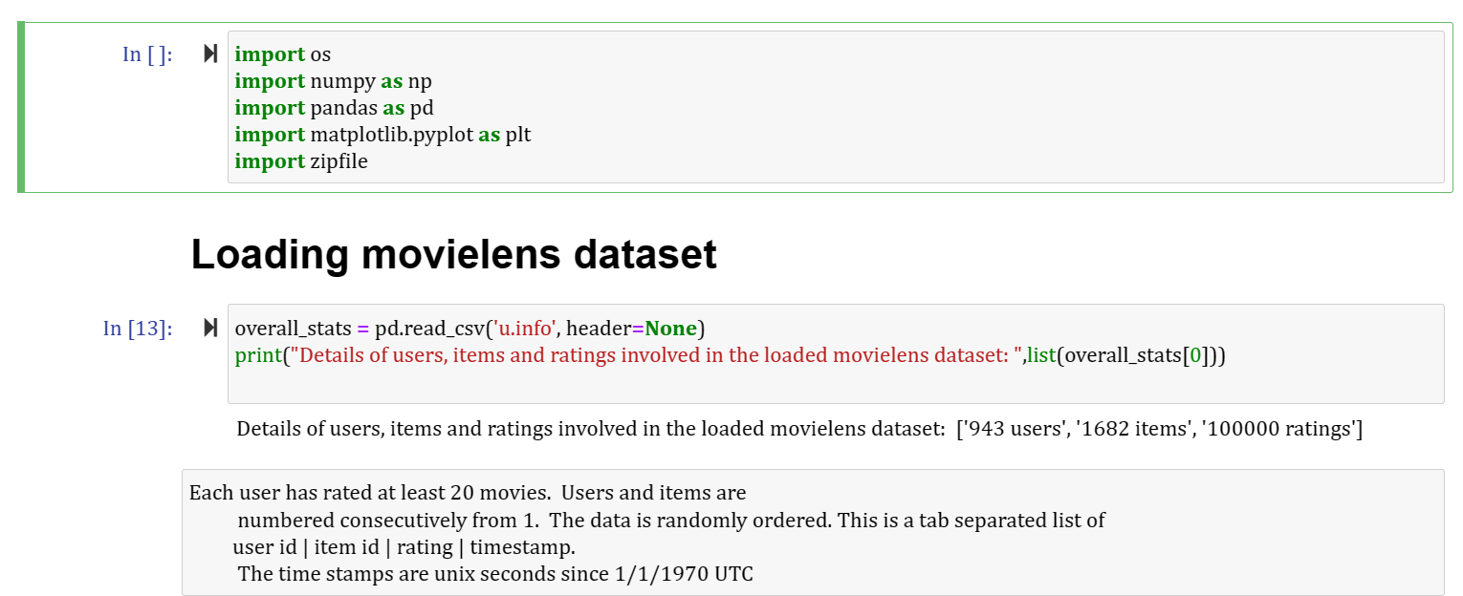
Movie recommender system

Slide 15
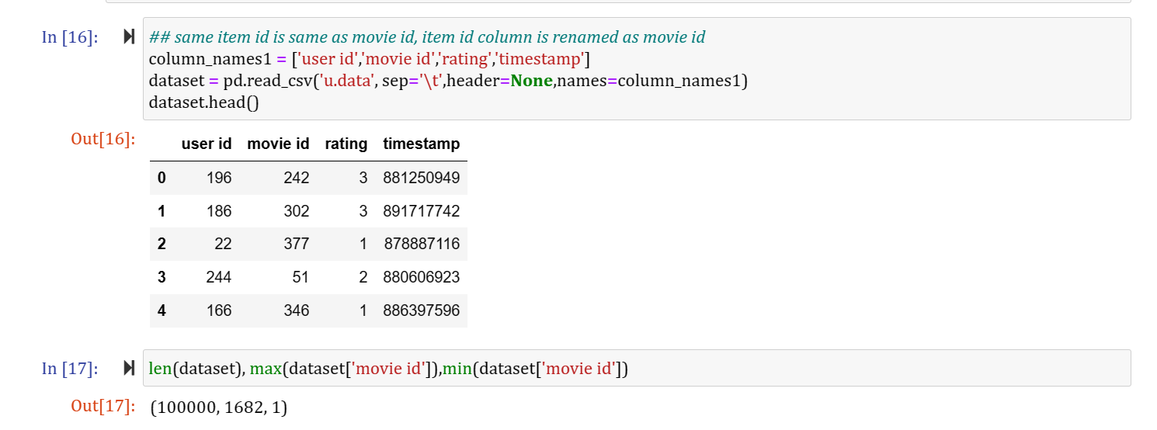

Slide 16
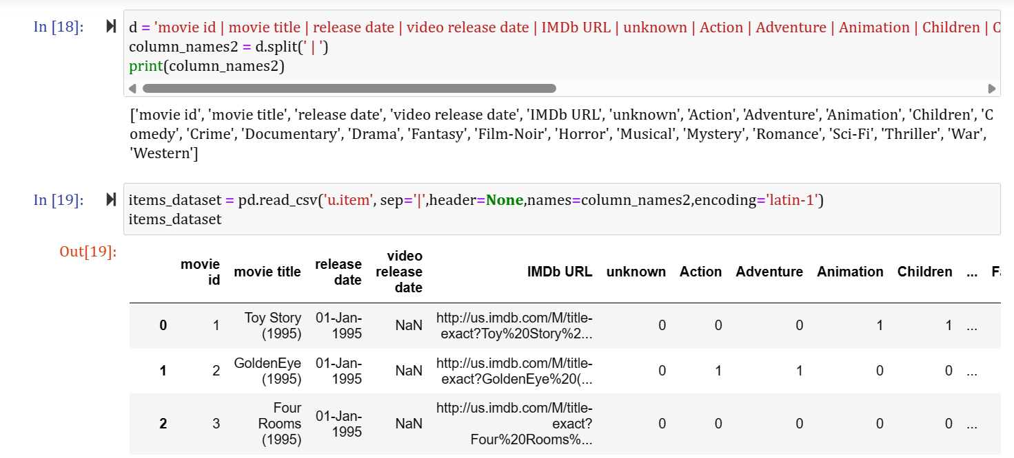

Slide 17
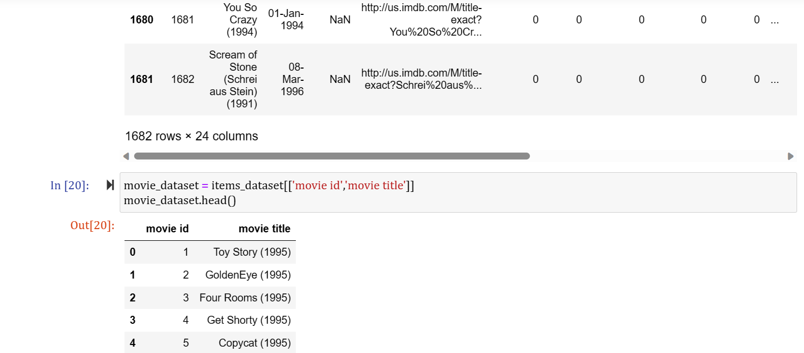

Slide 18
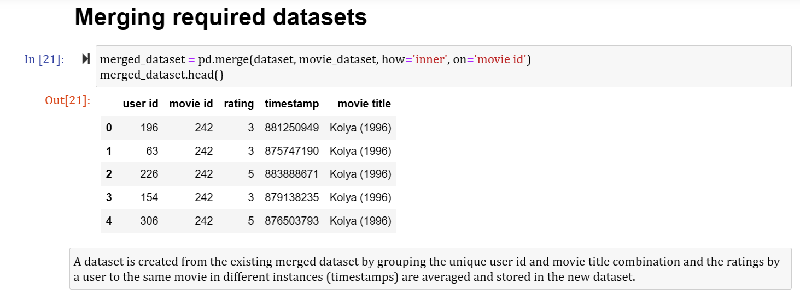

Slide 19
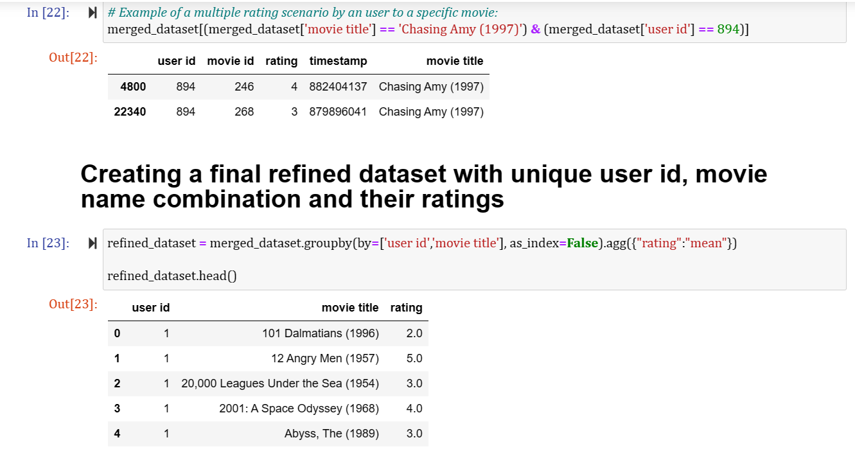

Slide 20
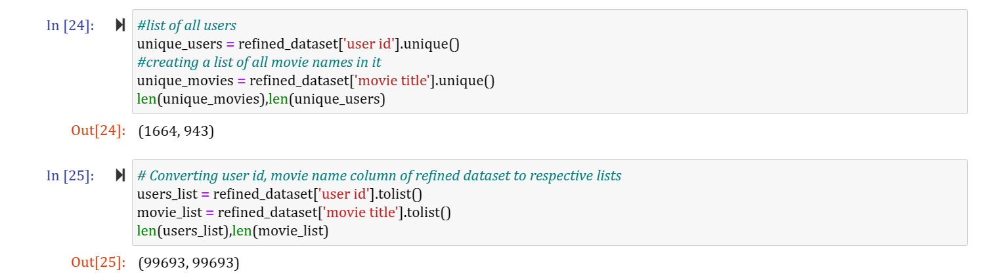

Slide 21
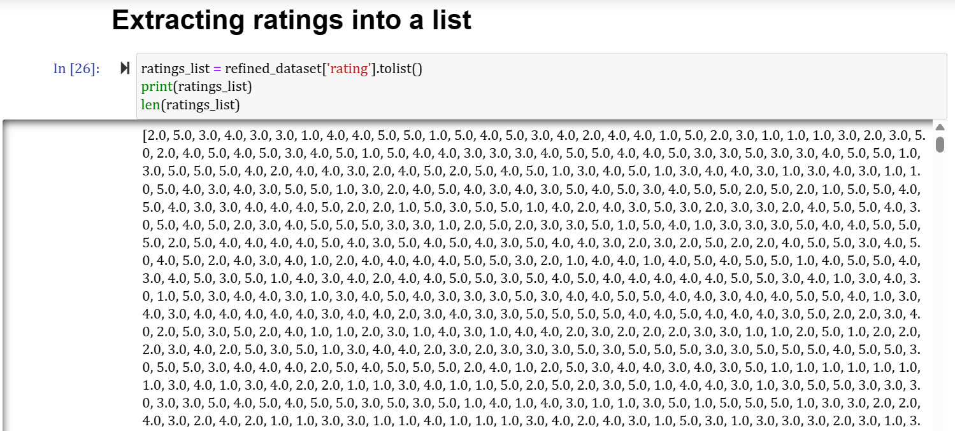

Slide 22
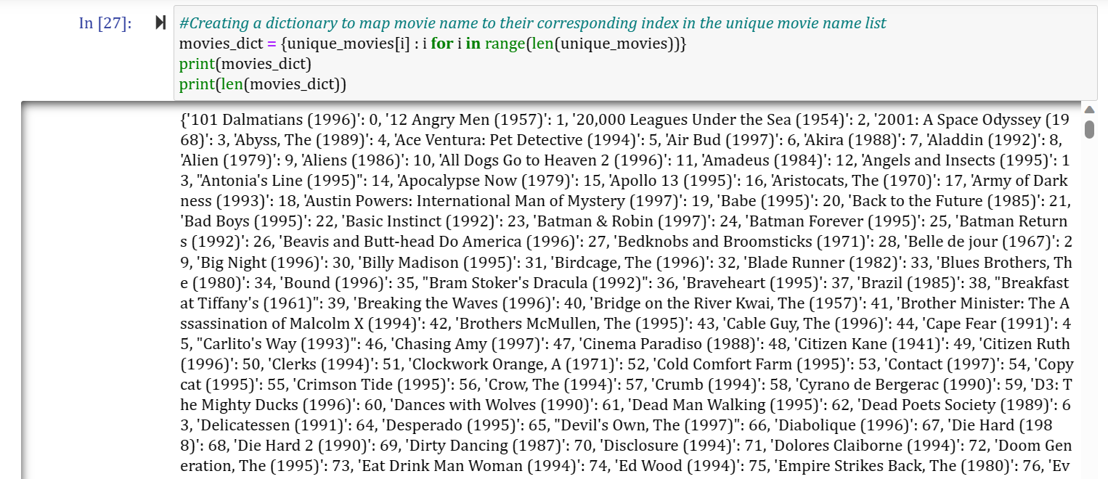

Slide 23
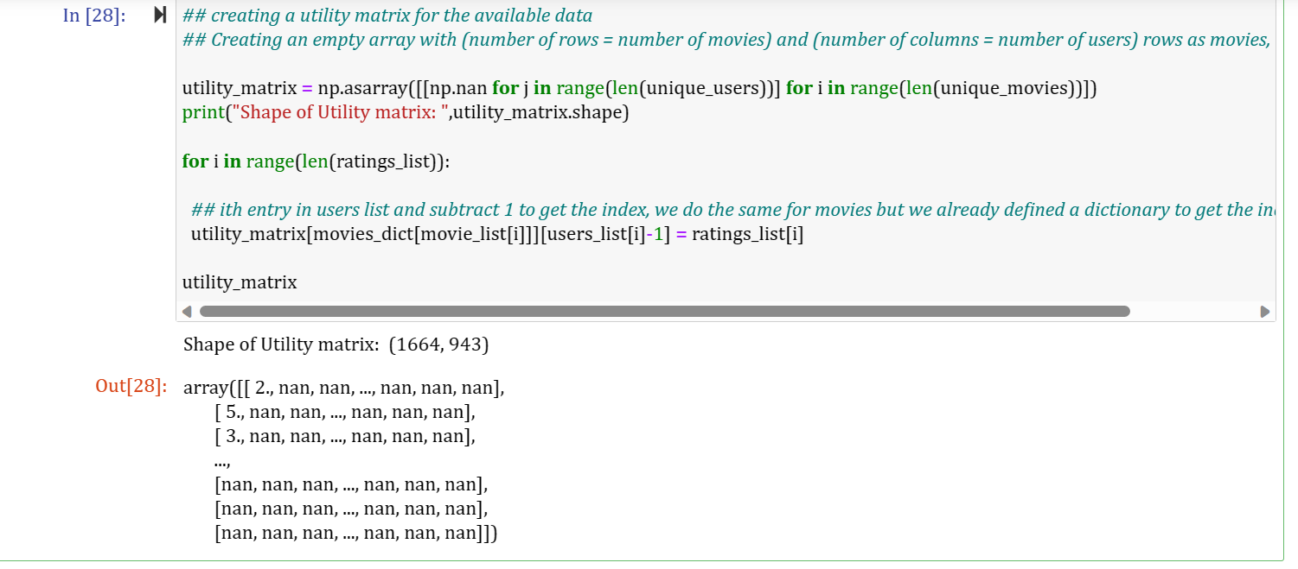

Slide 24
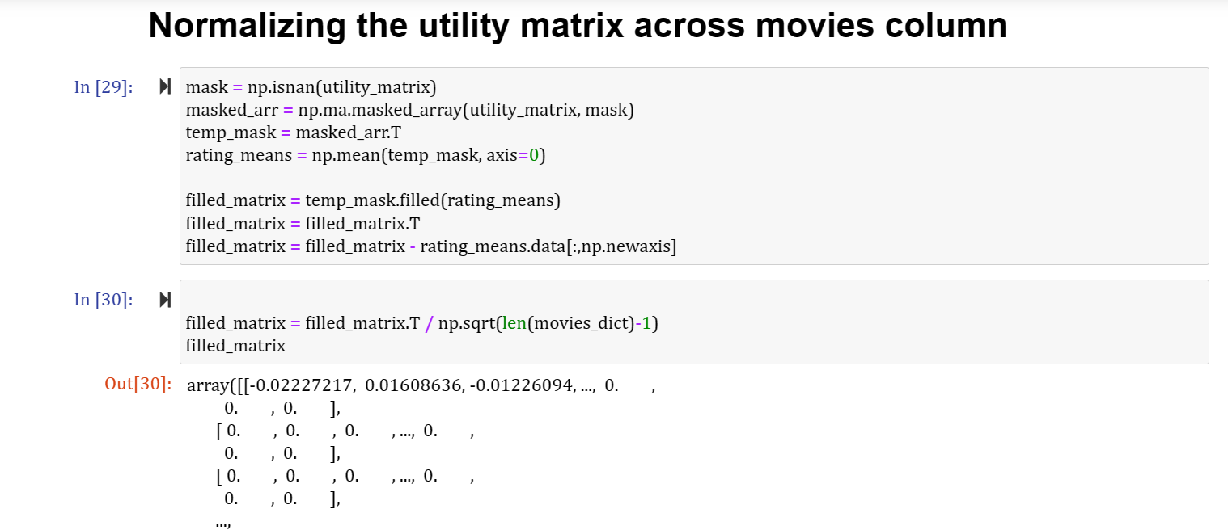

Slide 25
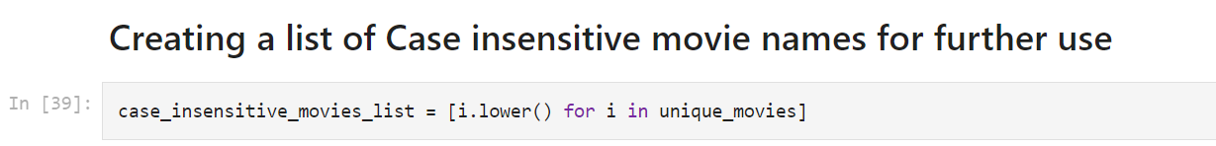
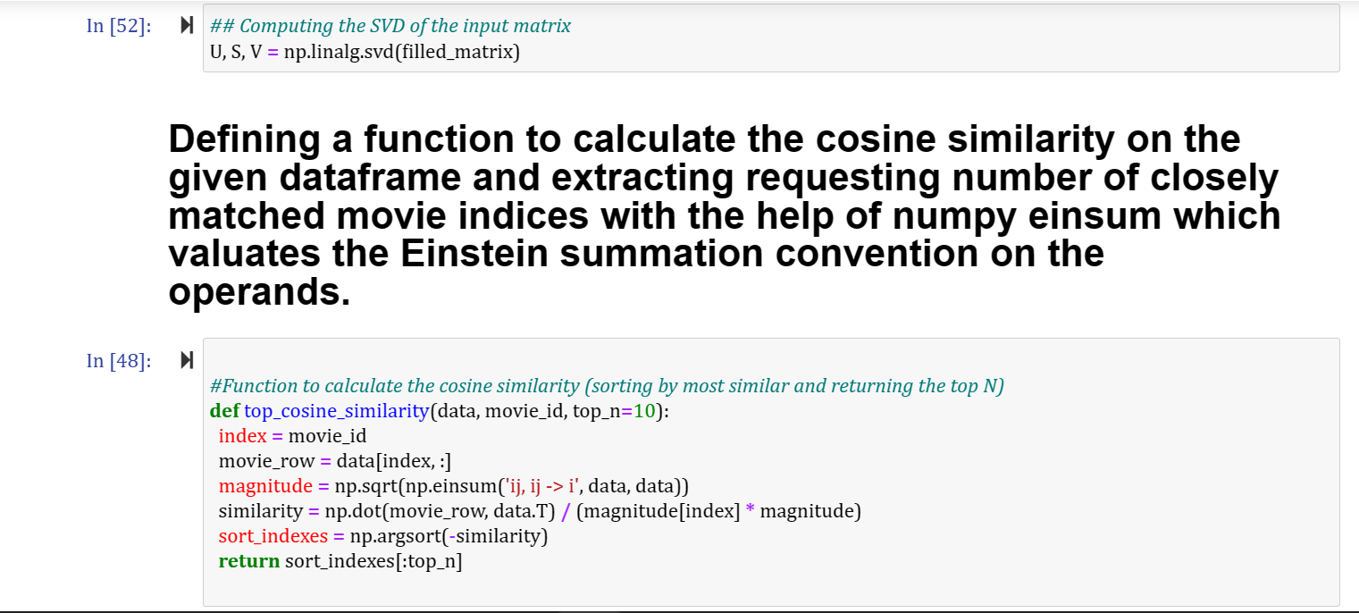

Slide 26
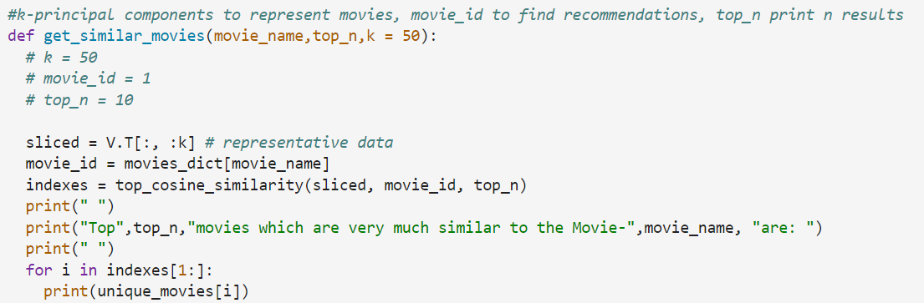
In SVD decomposition, Where A is a m x n utility matrix, U is a m x r orthogonal left singular matrix, which represents the relationship between users and latent factors, S is a r x r diagonal matrix, which describes the strength of each latent factor and V is a r x n diagonal right singular matrix, which indicates the similarity between items and latent factors. The latent factors here are the characteristics of the items, for example, the genre of the music. The SVD decreases the dimension of the utility matrix A by extracting its latent factors. It maps each user and each item into a r-dimensional latent space. This mapping facilitates a clear representation of relationships between users and items

Slide 27
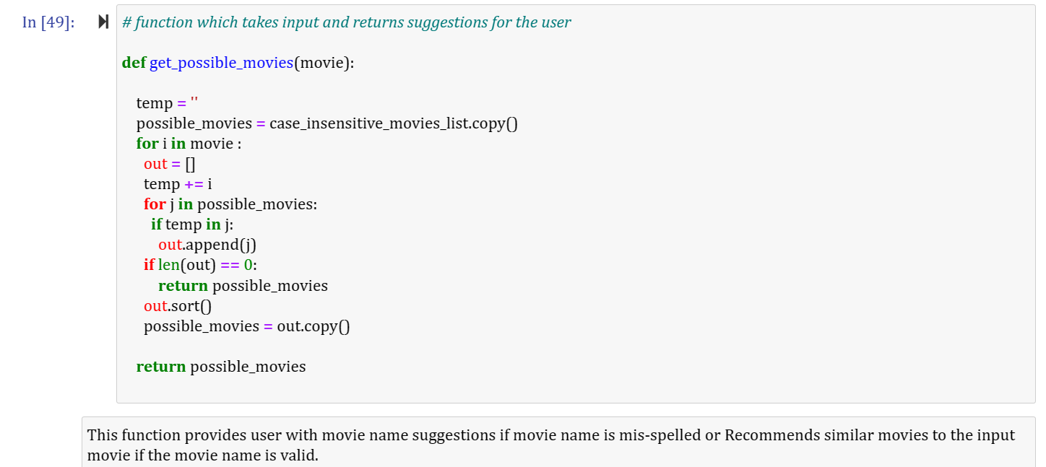

Slide 28
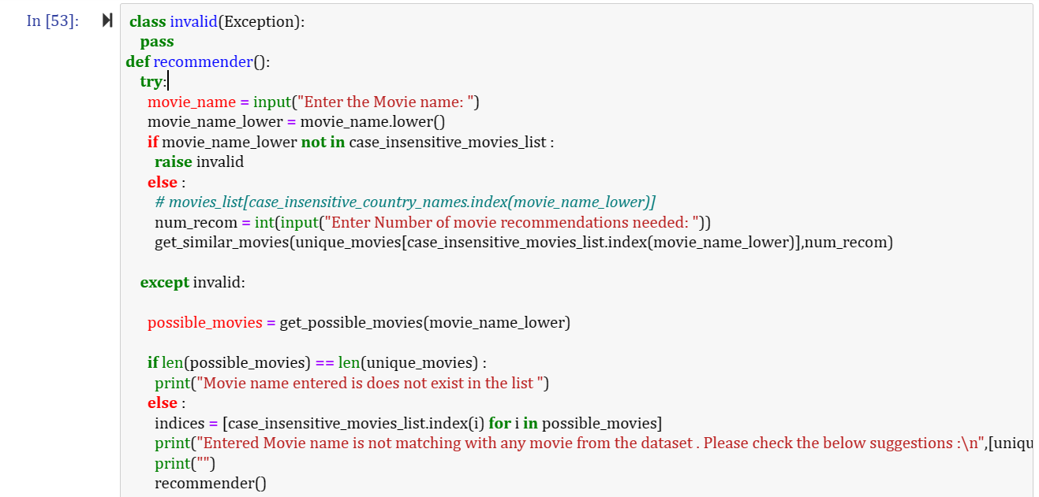

Slide 29
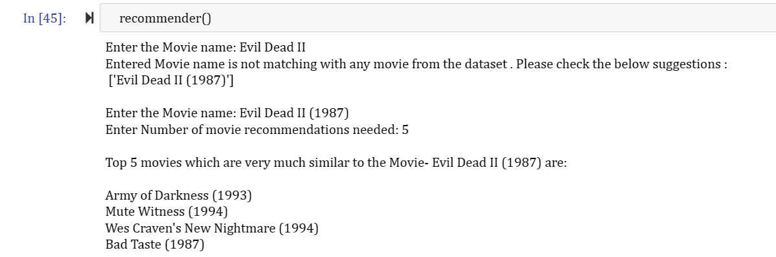
Recommending movies based on the movie name user enters

Slide 30
Complication: SVD assumes matrix R has all entries(But our matrix R has missing entries) !
SVD isn’t defined when entries are missing
We want to find matrices P and Q such that the squared differences between the predicted and observed ratings should be minimum
P,Q maps users/movies to low dimensional space
Here we consider the squared error because the estimated rating can be either higher or lower than the real rating.

Slide 31
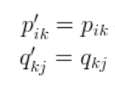
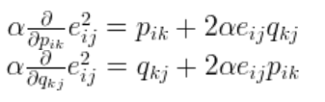
How to minimize our error function?
To minimize the error, we have to know in which direction we have to modify the values of Pik and Qkj . In other words, we need to know the gradient at the current values, and therefore we differentiate the above equation with respect to these two variables separately:
α is a constant whose value determines the rate of approaching the minimum
-
-

Slide 32
Overfitting & Regularization
Overfitting : The model is adopting too much to the training data & the model has too many free parameters which generates noise
To solve Overfitting we introduce
Regularization : we want our model to spend lots of modelling power where there is sufficient data & we want it to be simple where data is sparse( to reduce overfitting)
The new parameter β is used to control the magnitudes of the user-feature and item-feature vectors such that P and Q would give a good approximation of R without having to contain large numbers. In practice, β is set to some values in the range of 0.02.

Slide 33
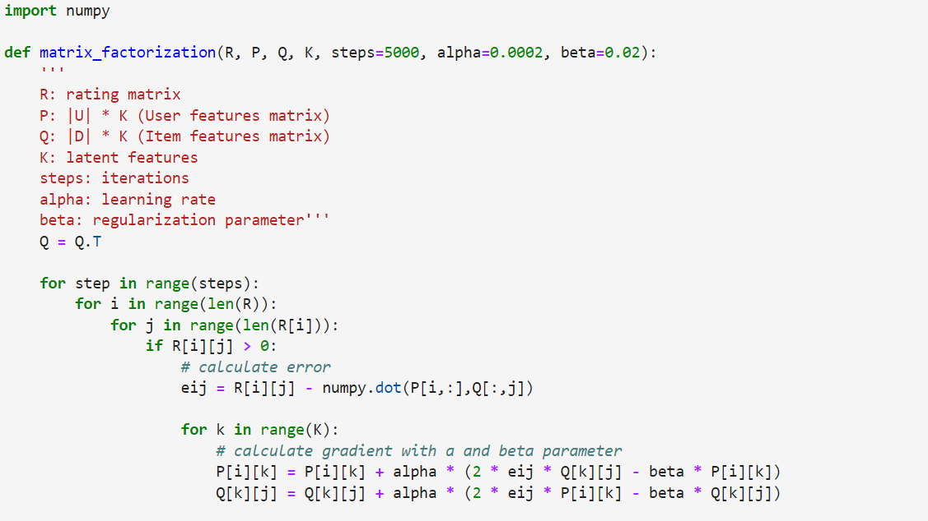
Python code for matrix filling using gradient descent
Below is the python code snippet to conduct the gradient descent algorithm. We set a rating matrix with 4 movies given by 6 users. As you can see, some users didn’t watch some movies before, so the rating is given as 0 in the rating.

Slide 34
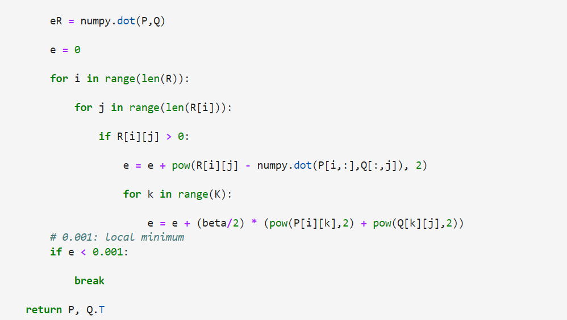

Slide 35
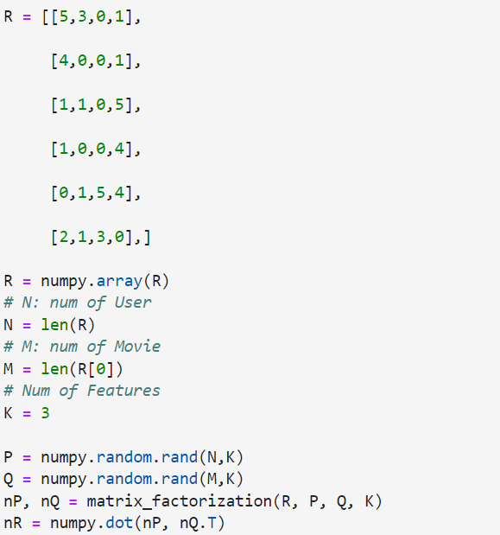
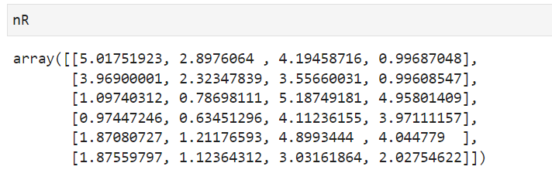
We can see that for existing ratings we have the approximations very close to the true values, and we also get some ‘predictions’ of the unknown values.
The error function RMSE is only calculated with the non-null rating. The missing entries in the rating matrix would be replaced by the dot product of the factor matrices. Therefore, we know what to recommend to the users with the unseen movies based on the prediction.

Slide 36
Alternating Direction Method of Multipliers

Slide 37
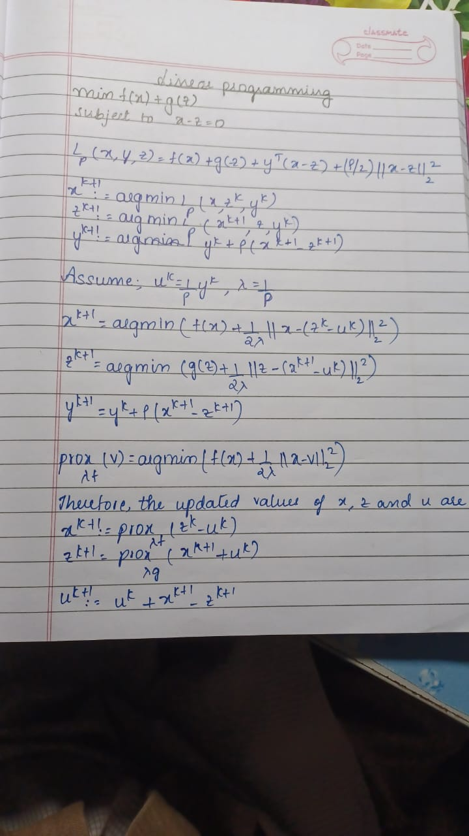
General ADMM formulation
minimize f(x) + g(z)
subject to x-z=0

Slide 38
Linear programming problem
A linear programming problem involves optimizing a linear objective function subject to linear equality and inequality constraints
ADMM provides an iterative approach to solving LP problems by decomposing them into smaller subproblems.
The general form of a linear programming problem is:
minimize c^T x
subject to Ax = b

Slide 39
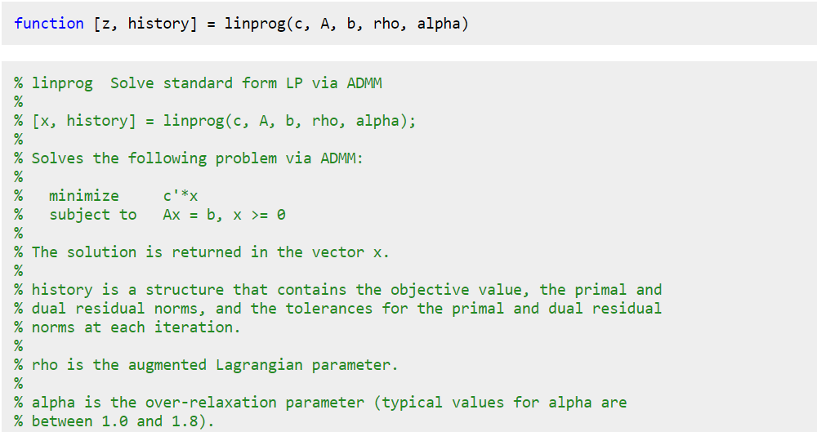
Implementation

Slide 40
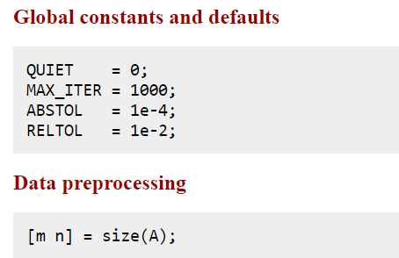
The QUIET parameter is set to 0, which means that the algorithm will produce output and display progress information during the optimization process
The values of ABSTOL and RELTOL determine the convergence criteria for the optimization algorithm
If the difference falls below this threshold, the algorithm is considered converged

Slide 41
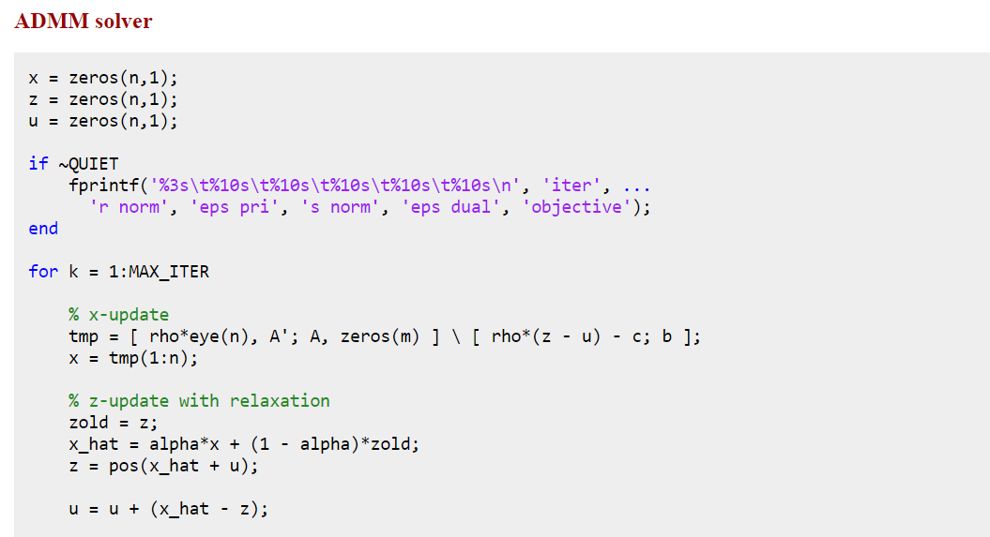
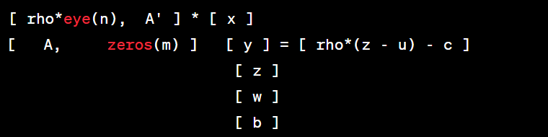
This part of the code initializes the variables x, z, and u with zero values and prepares for displaying optimization progress information if the QUIET flag is not set.
[ rho*eye(n), A'; A, zeros(m) ] \ [ rho*(z - u) - c; b ]: This expression solves the linear system of equations using matrix division (\). It computes the solution vector tmp that satisfies the equation:
zold = z;: This line creates a copy of the current value of z and assigns it to the variable zold. This is done to preserve the previous value of z for later calculations.

Slide 42
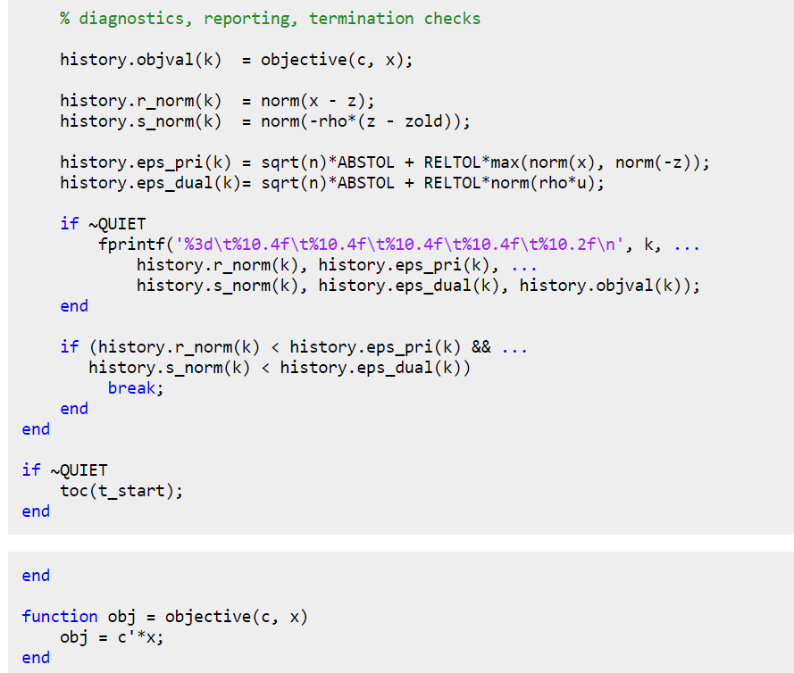
In the provided code snippet, several convergence metrics are calculated and stored in the history variable to track the progress of the optimization algorithm.
history.r_norm(k) = norm(x - z);: This line computes the norm (Euclidean distance) between the updated x and z variables, representing the primal residual norm
history.s_norm(k) = norm(-rho*(z - zold));: This line calculates the norm of the negative scaled difference between the updated z and the previous z (zold)
history.eps_pri(k) = sqrt(n)*ABSTOL + RELTOL*max(norm(x), norm(-z));: The resulting value represents the maximum acceptable discrepancy between the primal variables
history.eps_dual(k)= sqrt(n)*ABSTOL + RELTOL*norm(rho*u), The resulting value represents the maximum acceptable discrepancy between the dual variables

Slide 43
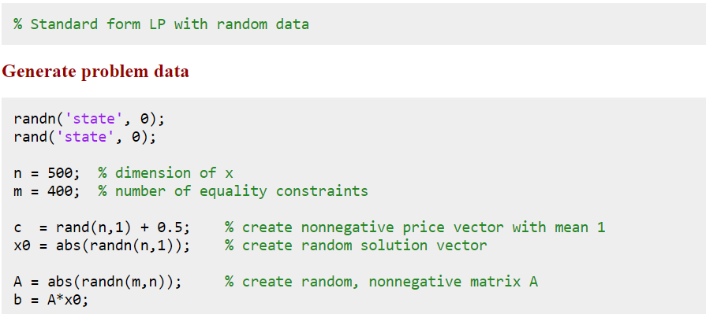
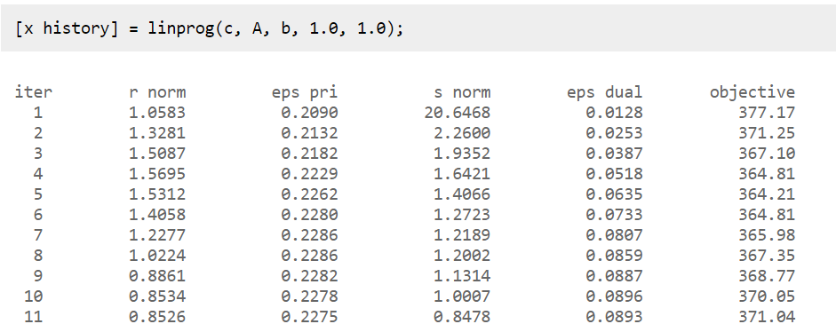

Slide 44
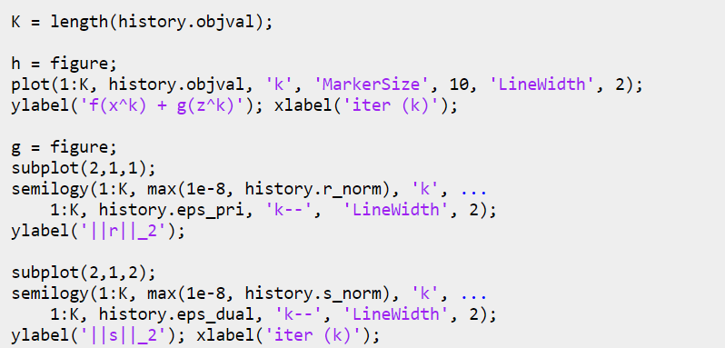

Slide 45
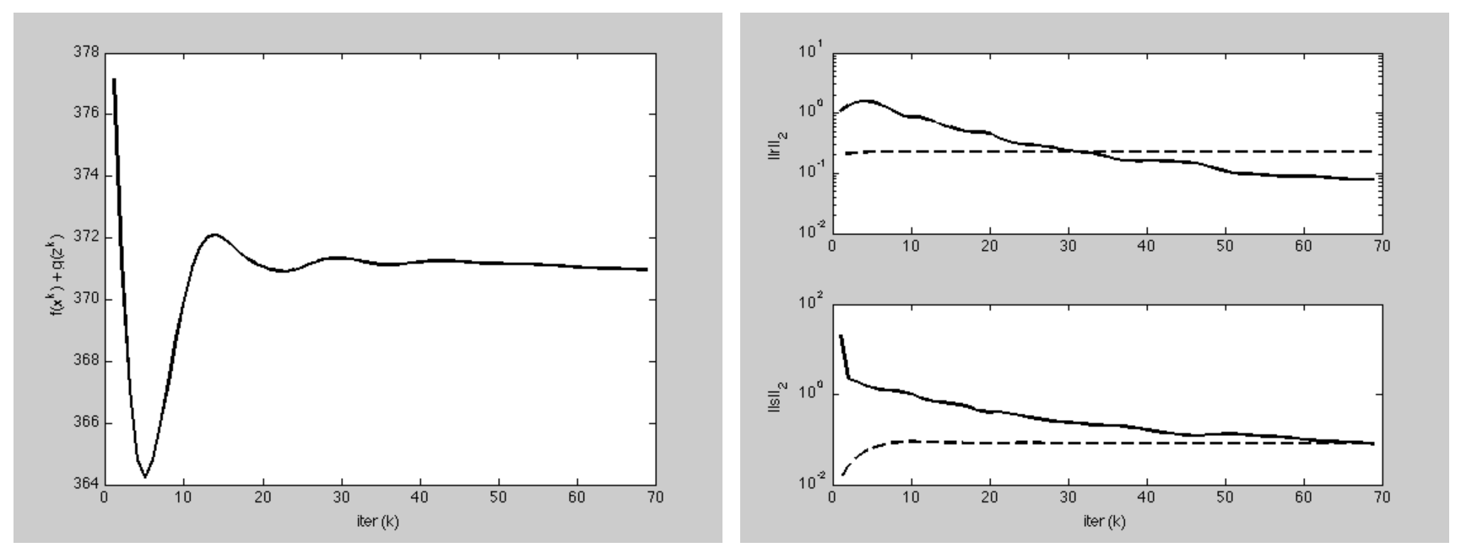

Slide 46
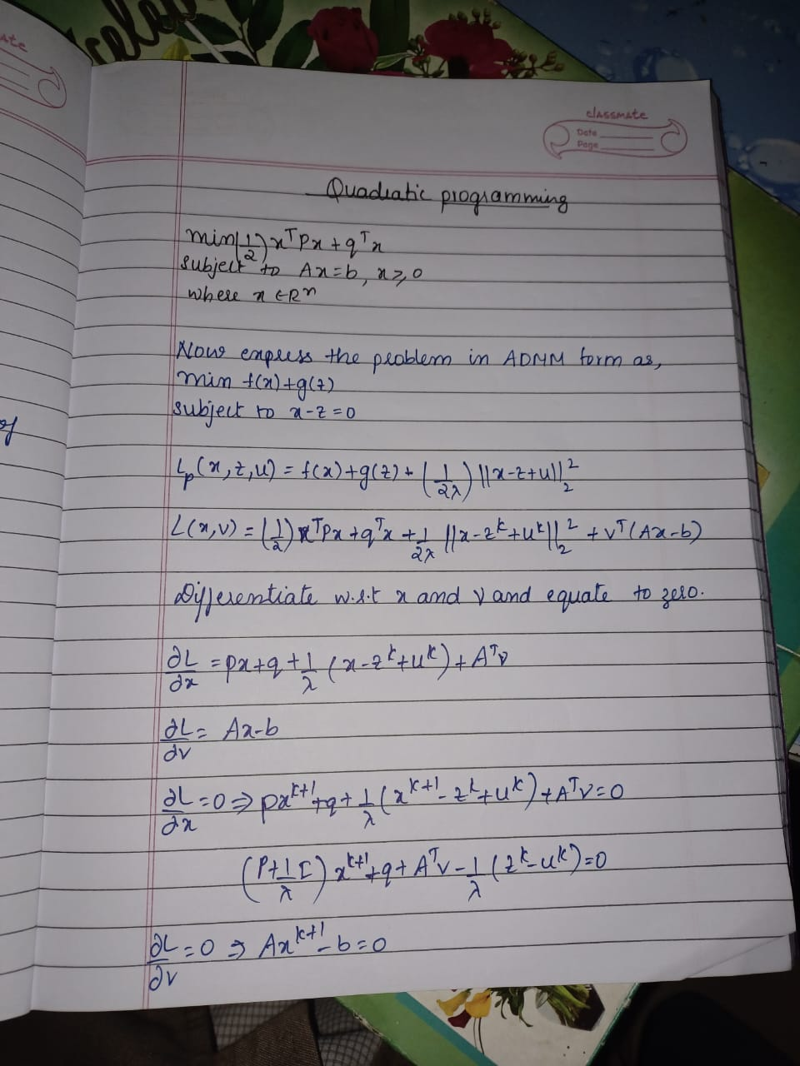
Quadratic programming problem

Slide 47


Slide 48

Implementation

Slide 49


Slide 50

R = chol(P + rho*eye(n));: This line computes the Cholesky factorization of the matrix P + rho*eye(n). The chol function is used to perform the factorization, which decomposes the matrix into the product of an upper triangular matrix R and its transpose
R \ (R' \ (rho*(z - u) - q)): This step involves solving the system Rx = y for x, where R is the upper triangular matrix obtained from the Cholesky factorization. The backslash operator is used again to perform the back substitution and obtain the solution x.
z = min(ub, max(lb, x_hat + u));: This line updates the z variable by adding the dual variable u to the blended value x_hat. The resulting sum is then constrained within the specified upper bound (ub) and lower bound (lb) limits. The min and max functions are used to enforce these bounds, ensuring that the updated z remains within the specified range.

Slide 51


Slide 52



Slide 53


Slide 54


